Slide 1
OASIS
Unit Enrolment Guide

Slide 2
Census Dates
Start Date | Classes commencement date
Last date to enroll via Estudent | 5 days after commencement date
Census date to withdraw without financial liability | 25 days (3 weeks) after commencement date – Students will not be financially liable in case they withdraw from a unit.
Results publication date | Information available on student account

Slide 3
Before Enrolling
Have you fulfilled all conditions on your offer?
If yes, lets get you enrolled in the units
If no, please contact your admission officer to submit your official documents or if you have an English test result to be submitted.

Slide 4
Important Notes
Core units – Important units which are part of your degree and should be completed when available
Elective Units – Units that can be taken from any course offered at Curtin Dubai campus. Prerequisites of the units should be completed and should not clash with core unit schedule.
Prerequisites – Units to be completed first before taking a higher level unit. This can be checked on the handbook http://handbook.curtin.edu.au
May trimester – It is important for students as there maybe units which are core and prerequisites for future units. If you wish to take a break, ensure that the units are available in the subsequent trimester.

Slide 5

Go to Curtin Dubai’s homepage.
Click on OASIS Login

Slide 6
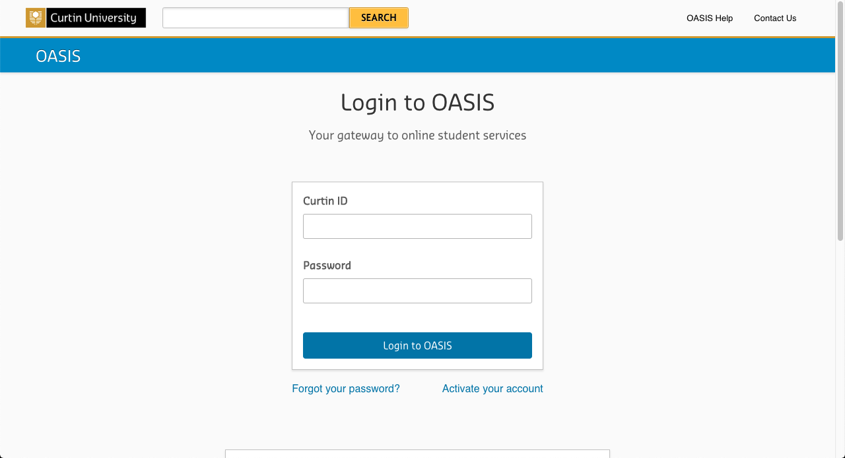
Log in to OASIS.
Available on offer letter

Slide 7
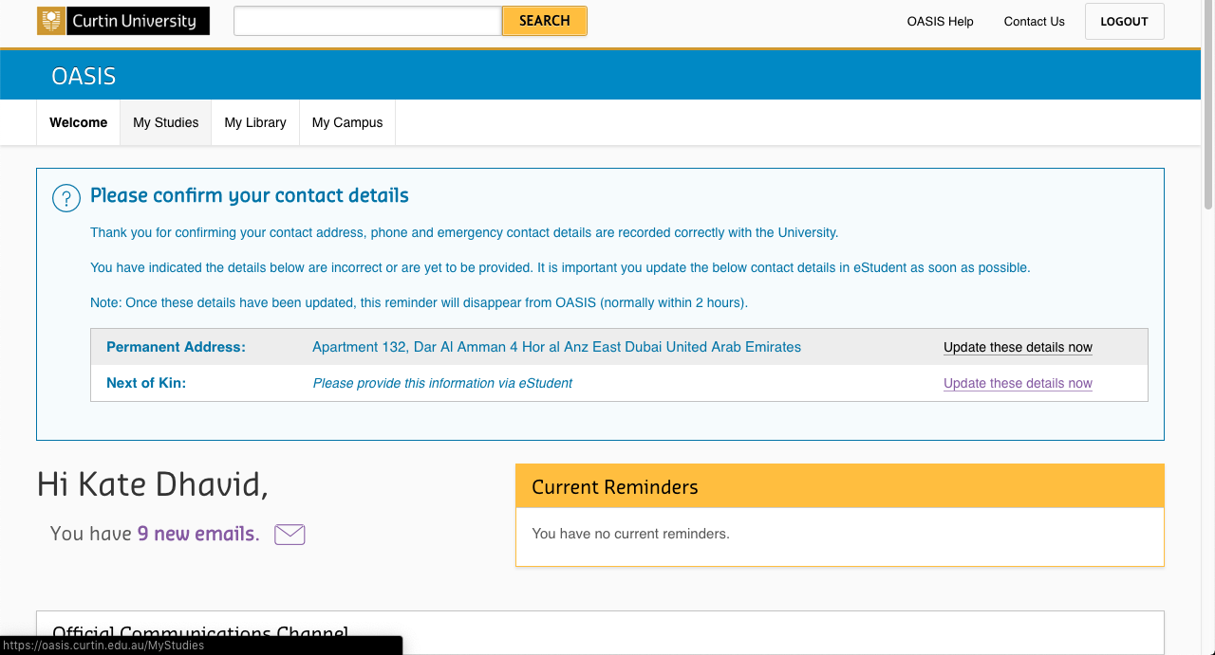
Click on the ‘My Studies’ tab

Slide 8
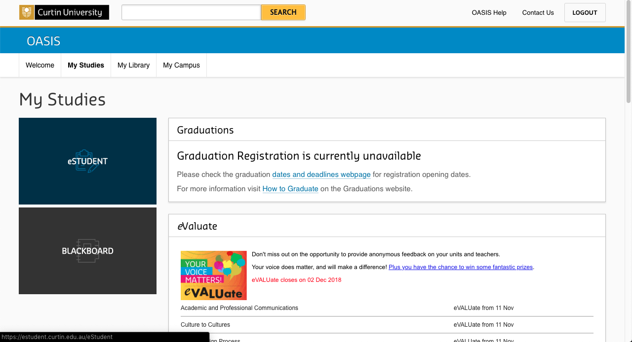
Click on ‘eStudent’

Slide 9
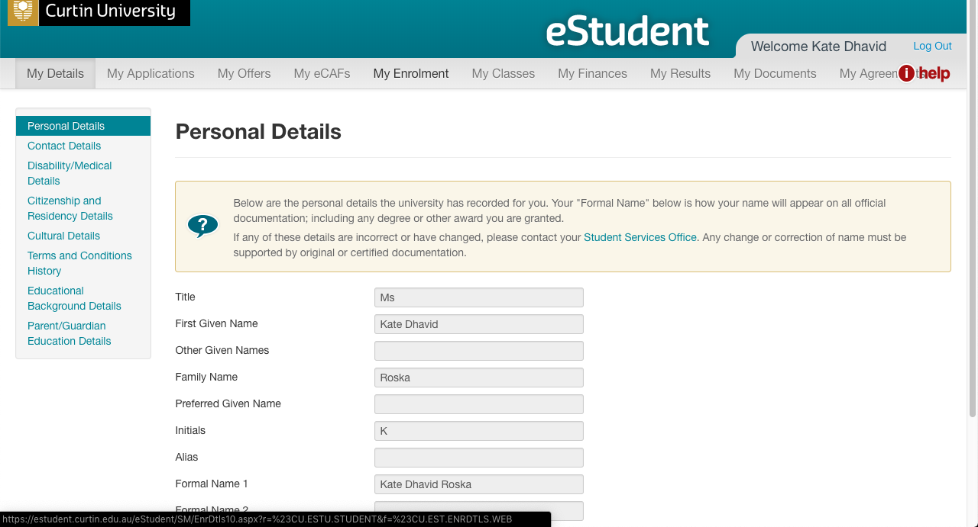
Note: A separate window for eStudent will pop up.
Click on the
‘My Enrolment’ tab.

Slide 10
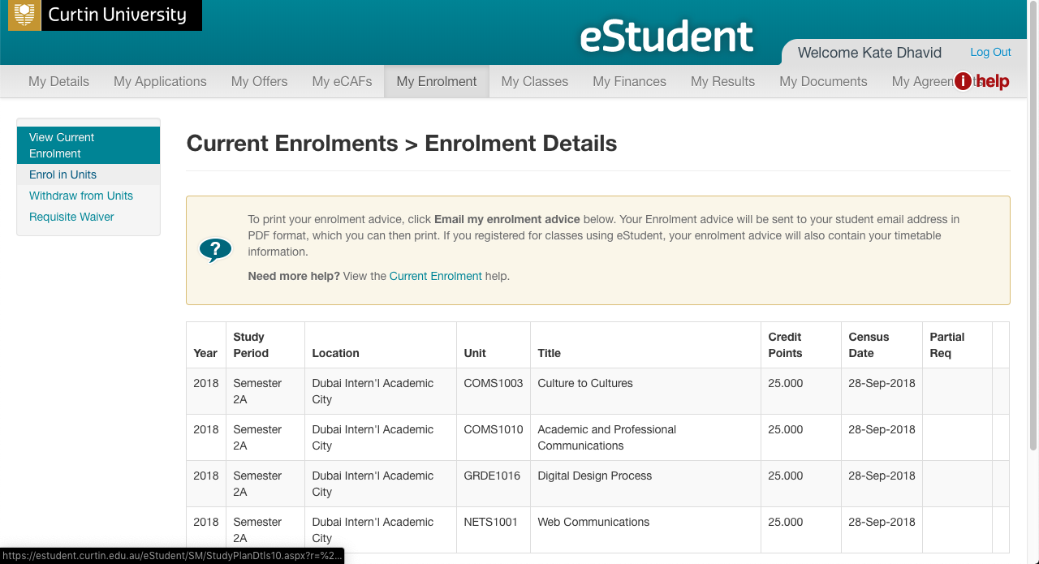
Click on
‘Enrol in Units’

Slide 11
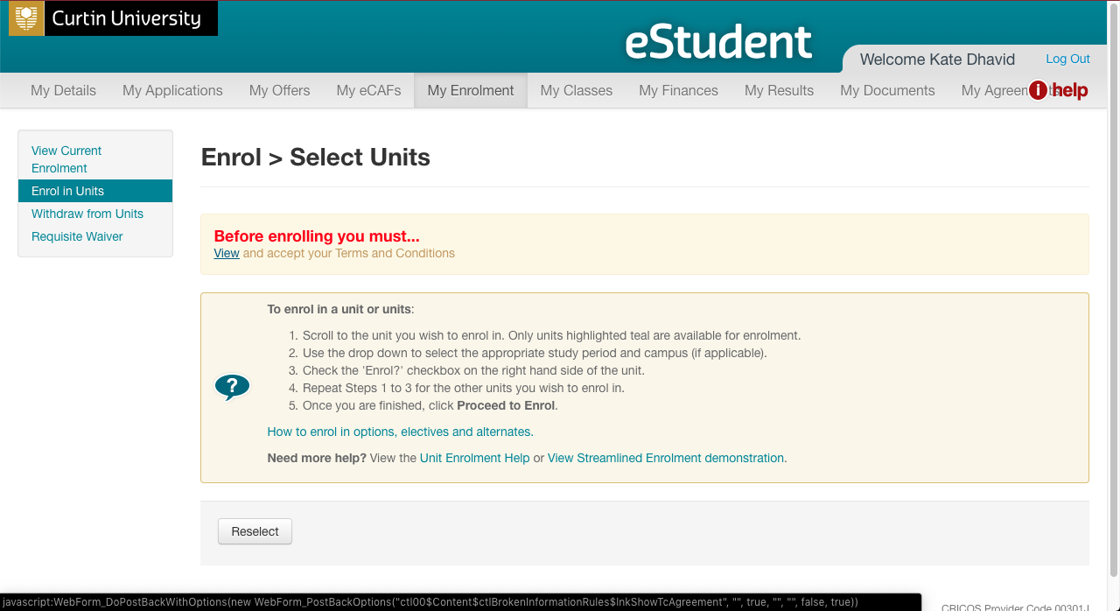
Warning message will appear for first-time users.
Click on ‘View’ to view the Institution Terms and Conditions’

Slide 12
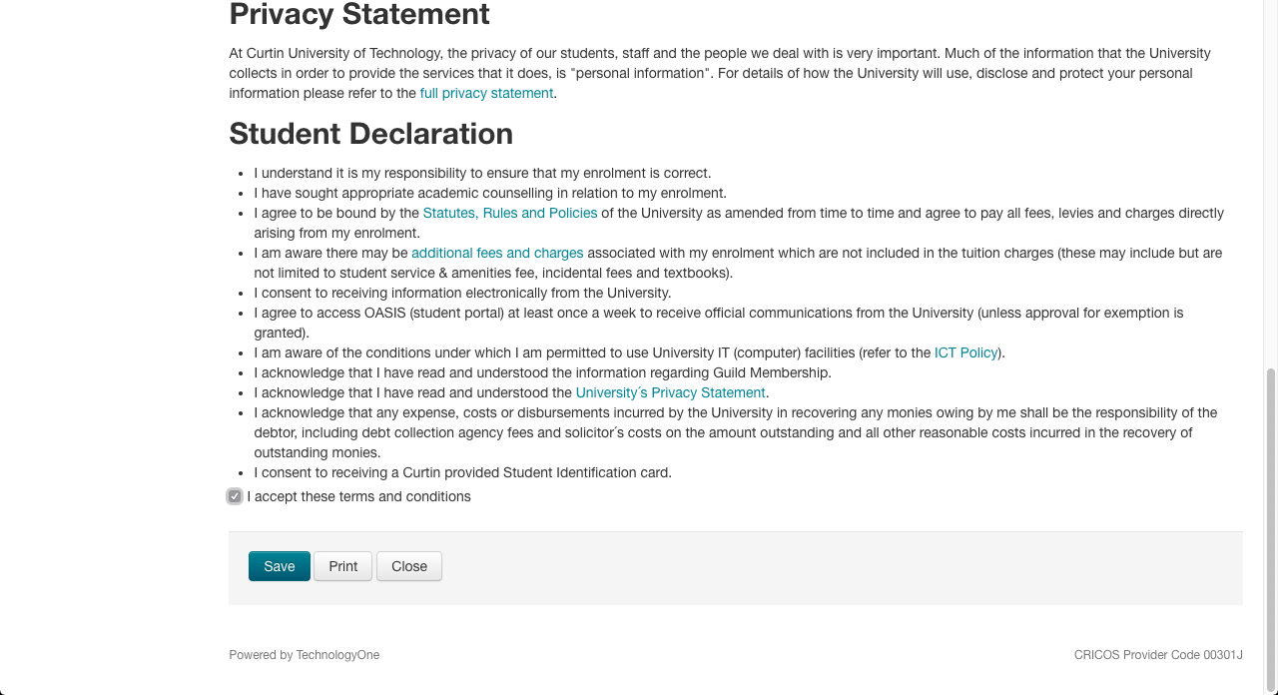
Institution Terms and Conditions
Please read and check ‘I accept these terms and conditions’.
Then click on ‘Save’.

Slide 13
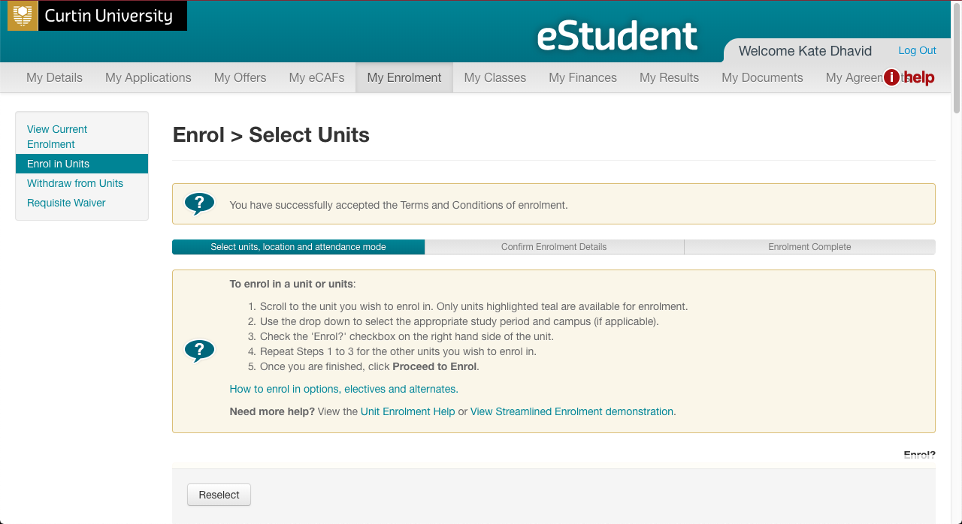
Confirmation of Acceptance

Slide 14
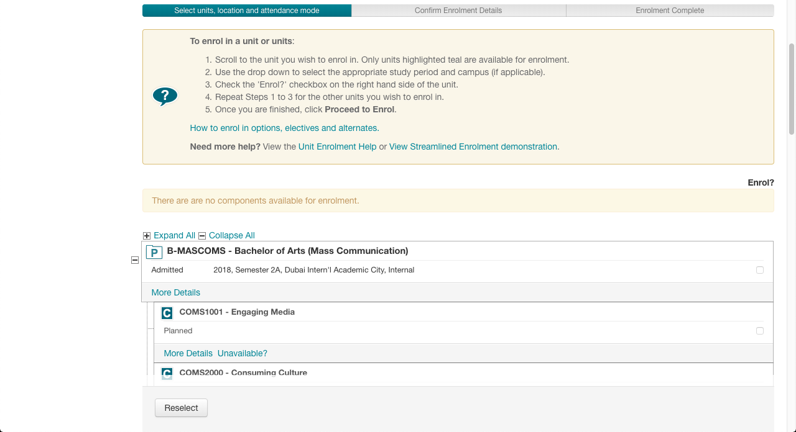
Note: Scroll down to see the units for enrolment.
Only highlighted units (in teal colour) are available for enrolment.
Please read the instructions in the yellow box.

Slide 15
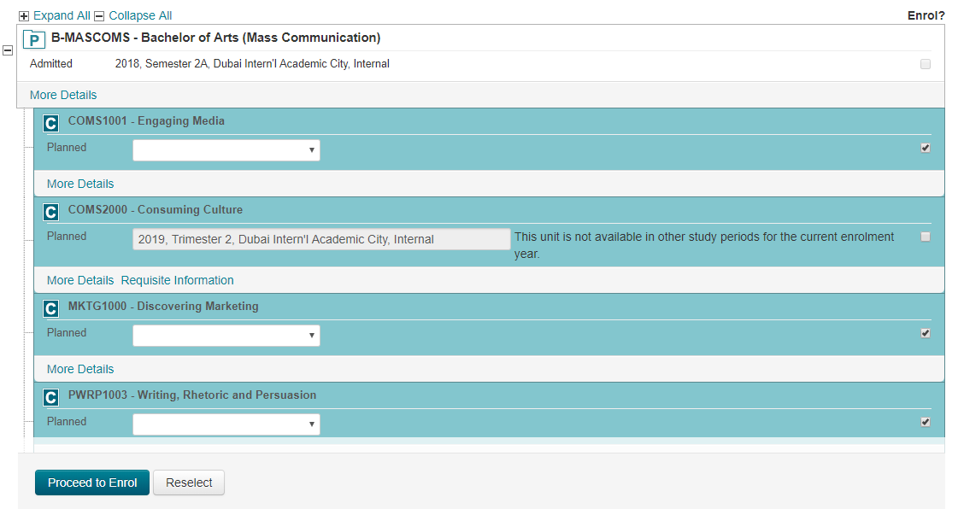
Use the drop down box of the selected unit, and select
‘2026, Semester 1, Curtin University Dubai, Internal’.
Then check on the respective box to enrol.
1. Select the correct availability.
2026, Semester 1, Curtin University Dubai, Internal
2. Check the box on the right of the selected unit(s).
3. Repeat steps 1 and 2 for all other units you wish to enrol in. Then click on ‘Proceed to Enrol’.
Notes:
I can’t get this one cos it says course unavailable

Slide 16
Undergraduate Courses
BH-ENGR Bachelor of Engineering (Honours) | Bachelor of Science (Psychological Science) | Bachelor of Design
MATH1020_Calculus for Engineers | BEHV2000_Psychological Science Experimental Methods | GRDE1005_Typography
MCEN1000_Engineering Mechanics | PSYC1002_Science and Professional Practice in Psychology | GRDE1015_Illustration Fundamental
ELEN1000 _Electrical Systems | PSYC1000 _Introduction to Psychology | GRDE1026_Start Design Thinking
NPSC1003_Integrating Indigenous Science and STEM* | Elective Unit | GRDE1027_Advertising Design 1

Slide 17
Postgraduate Courses
Master of Business Administration in International Business | Master of Engineering Management
ECOM5005_Business Analytics and Data Visualization | CSEN6000_Engineering Contracts, Legislation and Quality
ISYS5001_Business Project Management | CSEN6001_Engineering Economics and Whole-Cost Management
FNCE5008_Financial Principles and Analysis | CSEN6003_Engineering Quality Assurance Frameworks and Applications
ISYS5009_Societal Impact of Technological Innovation | ECON5012_Global Managerial Economics

Slide 18
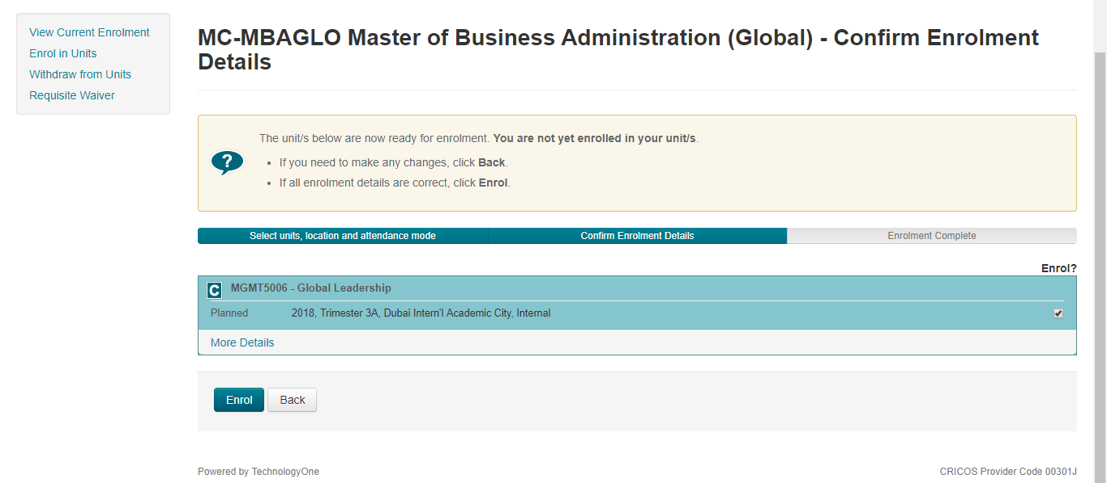
Enrolment Confirmation Details:
Check that the units selected are correct!
Click on ‘Enrol’ to finalise enrolment.
Notes:
Neither can I get this one

Slide 19
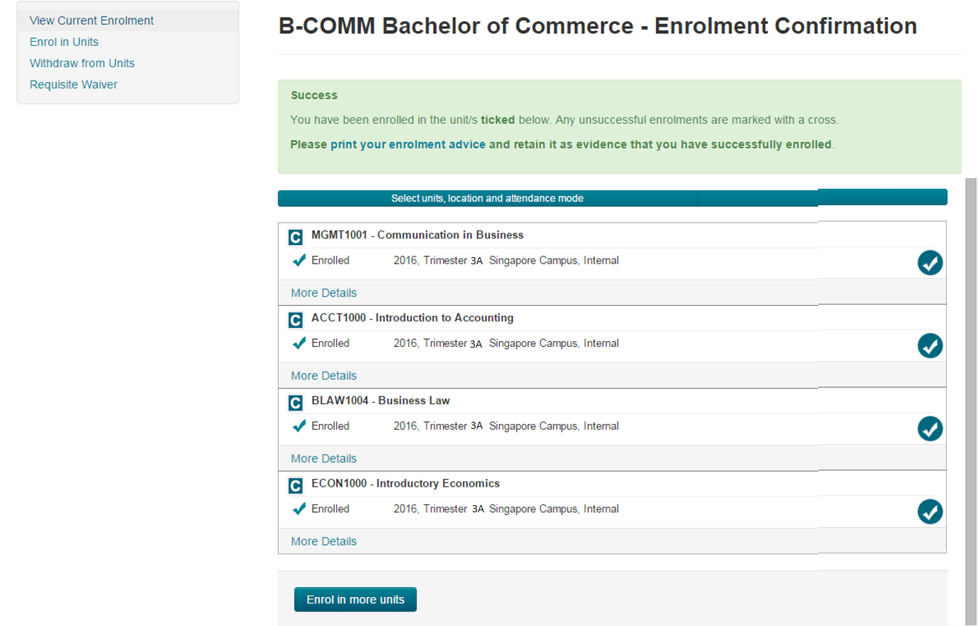
Your Unit Enrolment is now complete!
2018, Semester 2, Singapore Campus, Internal
2018, Semester 2, Singapore Campus, Internal
Click here if you need to ‘Enrol in more units’.
2018, Semester 2, Singapore Campus, Internal
2018, Semester 2, Singapore Campus, Internal
Notes:
Can’t get this one

Slide 20
If you need to retrieve your current enrolment details.
Click on ‘eStudent’

Slide 21
Note: A separate window for eStudent will pop up.
Click on the
‘My Enrolment’ tab.

Slide 22
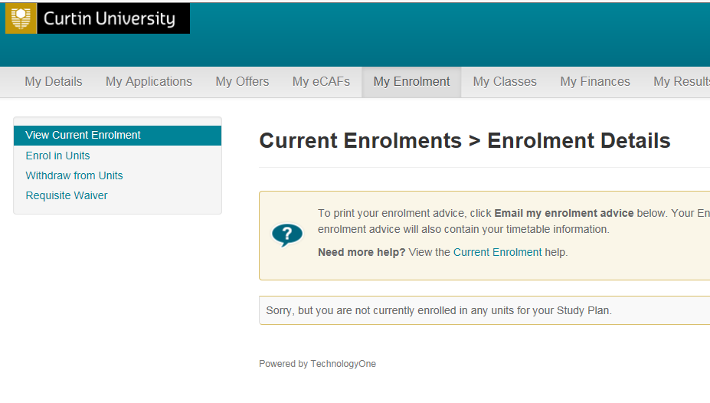
Select ‘View Current Enrolment’
If you face issues with your enrolment in OASIS, please contact Student Service Centre studentservicecentre@curtindubai.ac.ae

